Slide 1
EDA on S&P Composite Index

Slide 2
Summary of the Data
﻿ | S&P Composite | Dividend | Earnings | CPI | Long Interest Rate | Real Price | Real Dividend | Real Earnings | Cyclically Adjusted PE Ratio | return
count | 1814 | 1812 | 1809 | 1814 | 1814 | 1814 | 1812 | 1809 | 1694 | 1813
mean | 337.837394 | 6.90647801 | 15.6276161 | 62.8795419 | 4.49823787 | 645.84472 | 18.0510389 | 35.9585694 | 17.2660873 | 0.00465753
std | 715.414152 | 12.4231731 | 29.585386 | 76.8778035 | 2.30654543 | 774.340214 | 11.6140182 | 31.0303964 | 7.11715118 | 0.04059644
min | 2.73 | 0.18 | 0.16 | 6.27961322 | 0.62 | 75.6417097 | 5.57385551 | 4.68429624 | 4.78424105 | -0.2647374
25% | 7.91 | 0.421475 | 0.5633 | 10.2 | 3.16354167 | 191.247664 | 9.64815484 | 14.4038776 | 11.9038469 | -0.0149724
50% | 17.495 | 0.88835 | 1.476 | 20.7 | 3.81 | 290.362229 | 14.7649096 | 24.0915812 | 16.3874502 | 0.00671124
75% | 165.1 | 7.1908325 | 14.74 | 103.325 | 5.13 | 725.710163 | 22.9264016 | 44.8471796 | 20.9416332 | 0.02756308
max | 4674.77273 | 60.3971173 | 175.43 | 281.148 | 15.32 | 4692.48276 | 65.0088141 | 178.712398 | 44.1979398 | 0.50299401
Skewness | 2.97348253 | 2.54178876 | 2.46135117 | 1.33486045 | 1.78950849 | 2.32010673 | 1.89116748 | 1.75450088 | 1.00231901 | 0.39440418
Kurtosis | 9.95871575 | 6.28100383 | 5.61757854 | 0.33606236 | 3.75053244 | 5.75710619 | 4.0275653 | 2.75664557 | 1.33666905 | 17.0193974

Slide 3
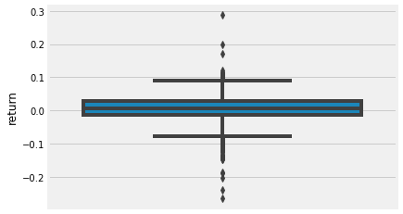
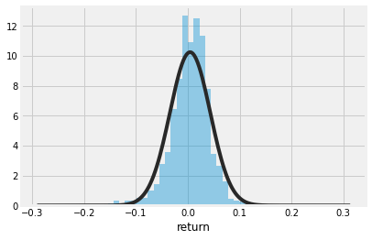
Analysis on Return
A Boxplot was created for anomaly detection purpose.
One outlier is identified from the chart, at 0.5, which has been replace by moving average of return.
Distribution of updated return has been compared with normal distribution, with new kurtosis 5.82

Slide 4
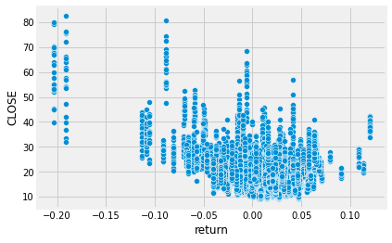
S&P Composite Index with VIX History
A negative correlation is identified between return and Closing figure.

Slide 5
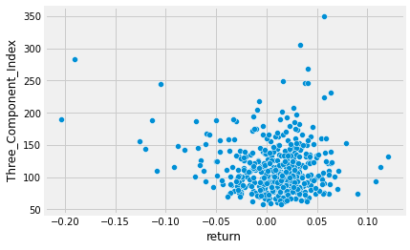
S&P Composite Index with US Policy Uncertainty
No obvious correlation between return and US policy uncertainty index.

Slide 6

Further Analysis
Value at Return at 95% confidence interval: ﻿-0.060
Expect Shortfall: ﻿0.048
Maximum Drawdown: 3﻿.02

